Slide 1
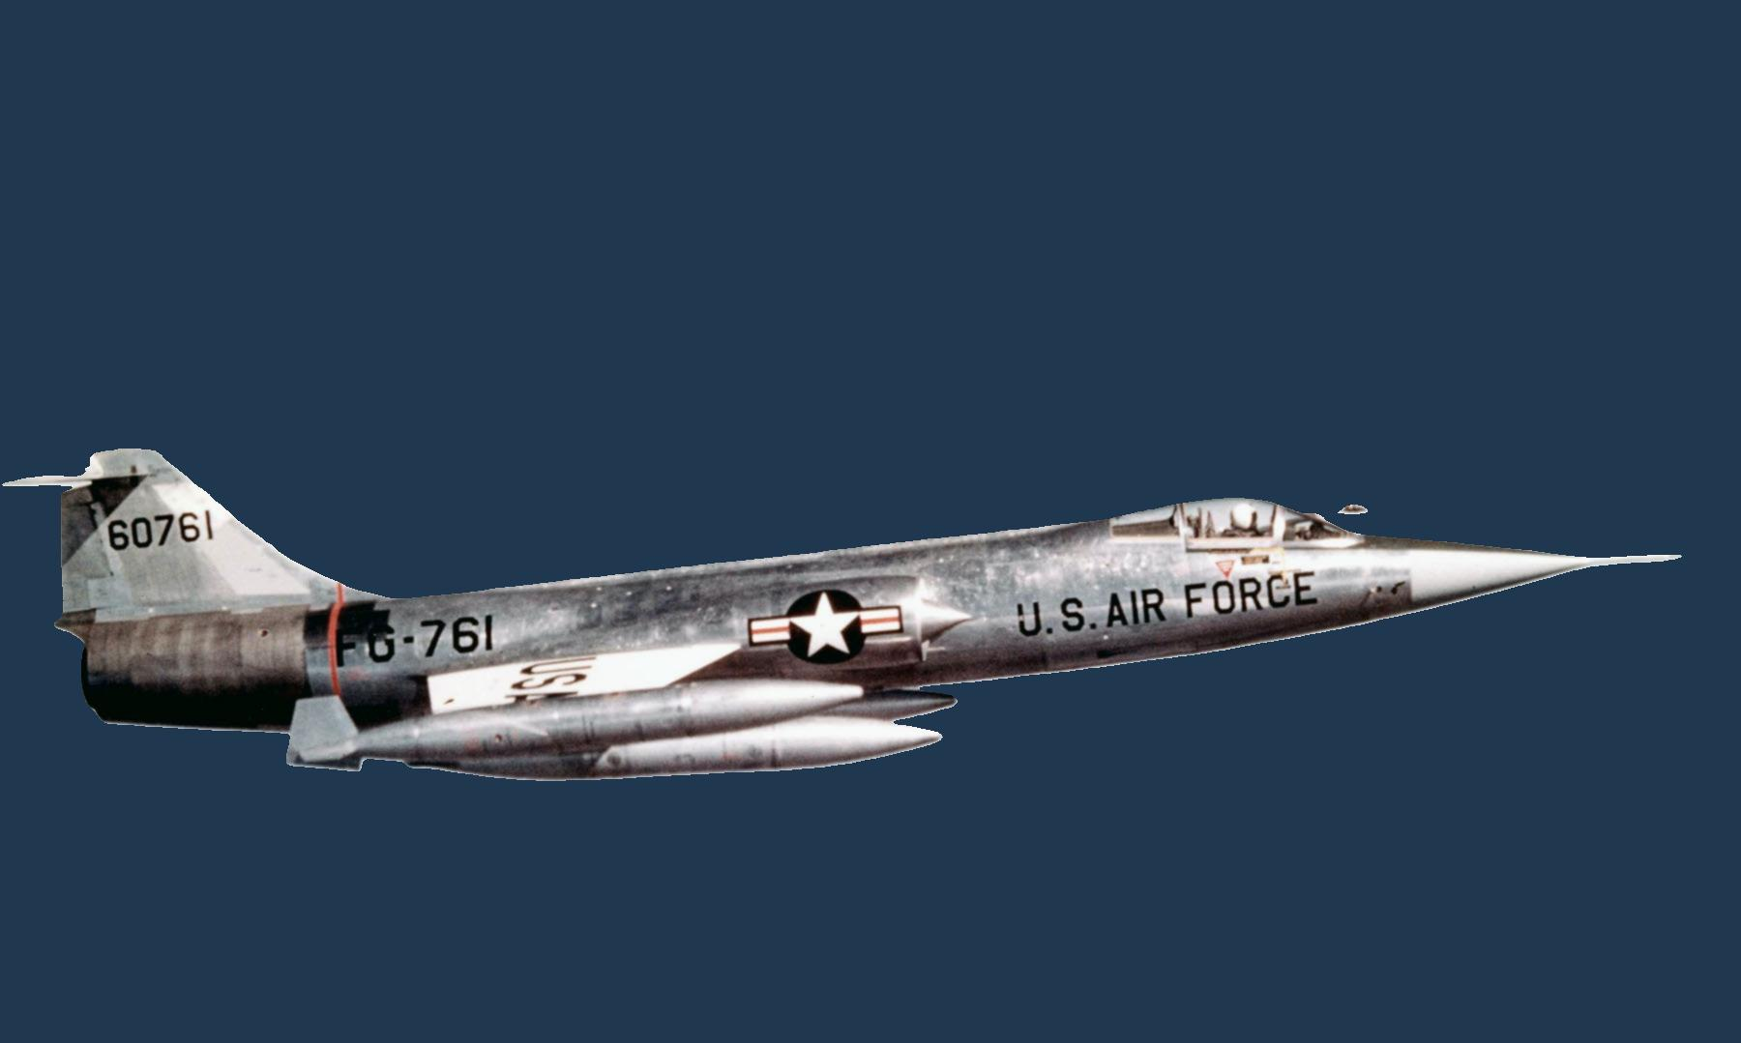

Lockheed F-104 Starfighter
Length | 54 ft 8 in
Wingspan | 21 ft 9 in
Height | 13 ft 6 in
Powerplant | 1 × General Electric J79, 15,600 lbf thrust
Empty weight | 14,000 lb
Max takeoff weight | 29,027 lb
Maximum speed | 1,528 mph (2,459 km/h, 1,328 kn)
Maximum speed | Mach 2
Combat range | 420 mi
Ferry range | 1,630 mi
Service ceiling | 73,000 ft
Rate of climb | 48,000 ft/min Initially
Guns | 1 × 20 mm (0.787 in) M61A1 Vulcan cannon
Hardpoints | 7 with a capacity of 4,000 lb
Missiles | 4 × AIM-9 Sidewinder
The F-104 was developed by Clarence "Kelly" Johnson and his team at the Lockheed Skunk Works in Burbank, CA. It first flew on March 4, 1954, and entered U.S. Air Force service in 1958. Several variants of the aircraft saw widespread use by NATO countries, particularly Germany, Italy, and Canada, with a total of 2,578 produced over its service life. It was retired from the USAF in 1967 and from all active service in 2004

Slide 2
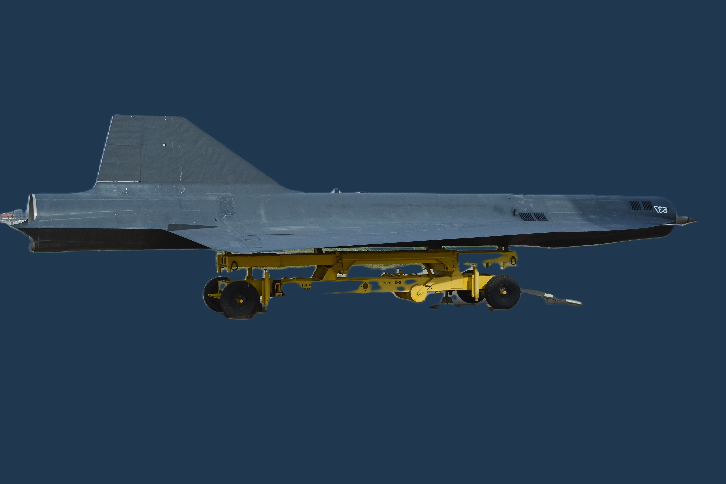
Lockheed D-21/B
Drone
Length | 42 ft 10 in
Wingspan | 19 ft 0.25 in
Height | 7 ft 0.25 in
Gross Weight | 11,000 lb
Powerplant | 1 × Marquardt RJ43-MA-20S4 ramjet, 1,500 lbf
Maximum Speed | Mach 3.35
Cruise Speed | 2,524 mph (Mach 3.32)
Range | 3,500 mi
Service Ceiling | 95,000 ft
The Lockheed D-21 was a Mach 3+ high-altitude reconnaissance drone developed in the 1960s by Skunk Works for covert surveillance over hostile territories. Initially launched from the M-21 (A-12 variant), it was later adapted for B-52H launches after a fatal accident. Powered by a Marquardt RJ43 ramjet, it could fly over 95,000 feet with a range of 3,500 miles. The drone carried film cameras, ejecting canisters mid-air for retrieval. Despite four operational missions over China under Project Senior Bowl, none succeeded. The program was canceled in 1971

Slide 3
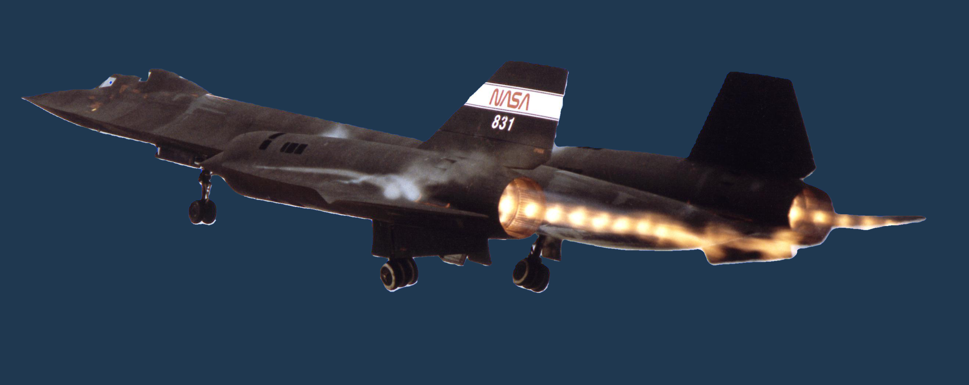
Lockheed SR-71
Blackbird
Speed | Mach 3.3+ (2,200+ mph)
Range | 2,900 miles
Service Ceiling | 85,000 ft
Engines | 2 × Pratt & Whitney J58 turbojet/ramjet engines
Length | 107 ft 5 in
Wingspan | 55 ft 7 in
Height | 18 ft 6 in
The Lockheed SR-71 Blackbird was a Mach 3+ strategic reconnaissance aircraft developed by Skunk Works in the 1960s. Designed for high-speed, high-altitude intelligence gathering, it could fly at 85,000 feet and outrun missiles. Powered by two Pratt & Whitney J58 engines, it reached speeds over 2,200 mph. Its titanium airframe withstood extreme heat and its radar-absorbing design reduced detection. The SR-71 set multiple speed and altitude records, with 32 built. Retired in 1999, it remains one of the fastest air-breathing aircraft ever.

Slide 4
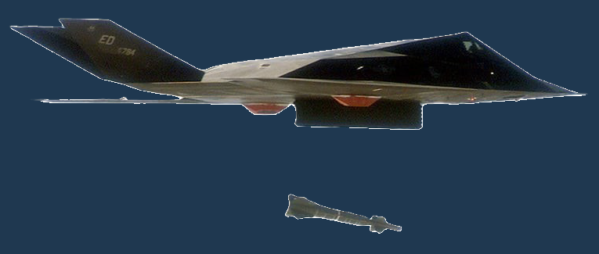

Lockheed F-117A
Nighthawk
Speed | ~Mach 0.92 (617 mph)
Range | 1,070 miles
Service Ceiling | 45,000 ft
Engines | 2 × General Electric F404-GE-F1D2 turbofans
Length | 66 ft 9 in
Wingspan | 43 ft 4 in
Height | 12 ft 9.5 in
The F-117A Nighthawk is a stealth attack aircraft developed by Lockheed’s Skunk Works for the U.S. Air Force. First flown in 1981 and revealed in 1988, it was designed for radar evasion using its faceted shape and radar-absorbent materials. Powered by two General Electric F404 engines, it reached speeds of 617 mph (Mach 0.92) with a range of 1,070 miles. Armed with laser-guided bombs, it excelled in precision strikes during conflicts like Panama, the Gulf War, and Kosovo. Retired in 2008, some F-117As remain active for training and testing. The Nighthawk remains an icon of stealth technology and a symbol of innovation in military aviation.

